Slide 1
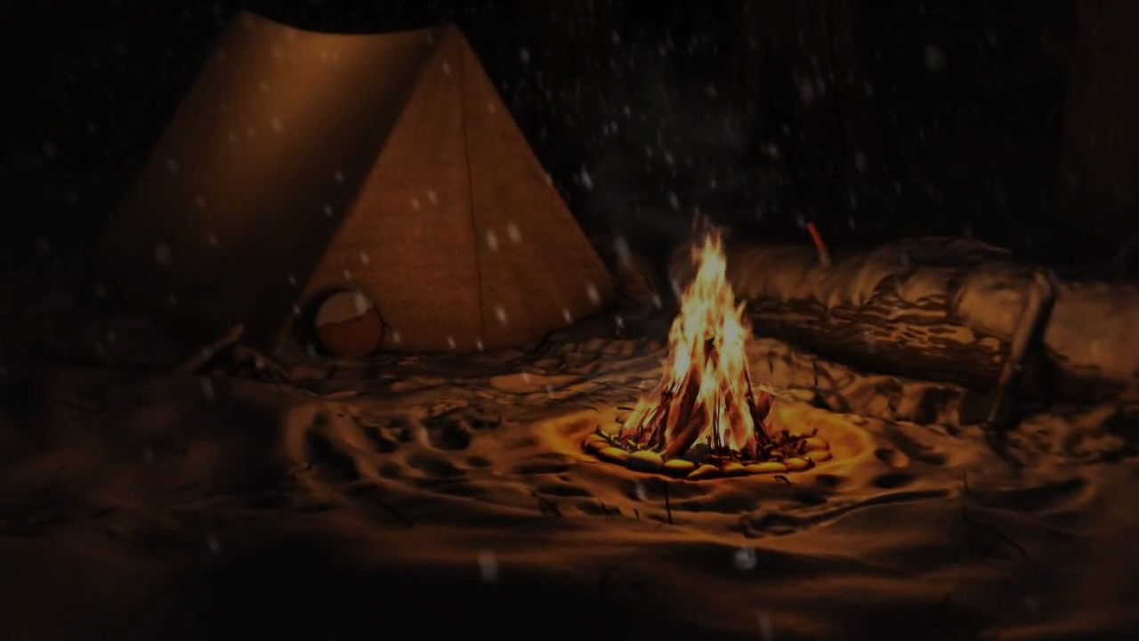
Building a Campfire! Survival Skills
Team - Super Hot Fire: Khandker Faim Hussain - 300773610 Slade Sieger - 300814981 Selina Daley - 300792374
Notes:
Faim

Slide 2

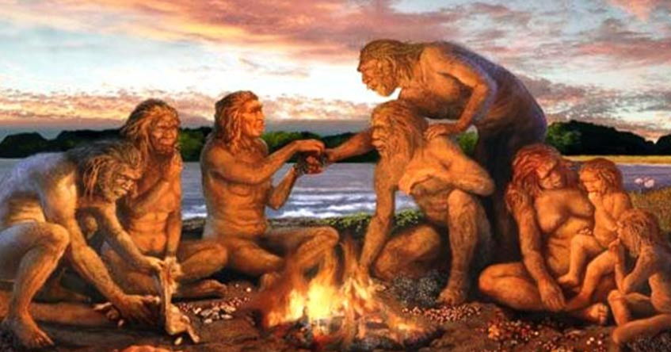
Why Learn This?
Creating a fire by hand is one of the most ancient techniques humans should know. This is important especially if they go camping or if they get lost in the forest and can’t go back home.
Notes:
Faim

Slide 3
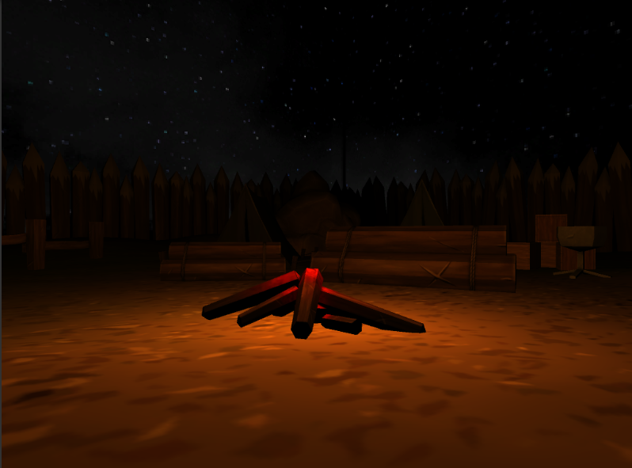
Gameplay
There will be two main portions to this game:
Part 1
The initial start of the game is where the player will be encouraged to find the required materials in the forest. The necessary materials will be using light sources to tell the player to take these items.
Notes:
Faim

Slide 4
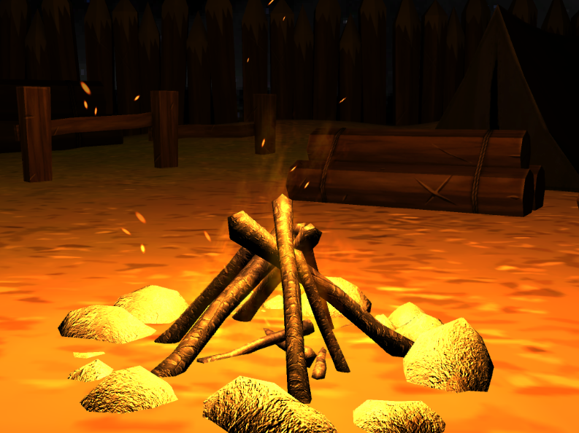
Gameplay cont’d
Part 2
The main part is where the player will use the collected materials to build the campfire via a mouse dragging mechanic and a UI indicating if the player is successful or not.
Notes:
Slade

Slide 5
Potential Future Features
Difficulties
Easy and hard difficulties or an easy or hard level. The easy level could provide instructions for the user to learn; whereas, the hard level will let the user test their knowledge.
An idea for implementing and distinguishing difficulties is by using different methods on building a fire. IE. Easy mode will make the player use a match and hard mode will require the player to find and use wood and/or rocks to create the fire.
The difficulty selected by the player could be used to determine the method in which the player will light the fire. (ex: match, flint, sticks)
Notes:
Selina

Slide 6
Potential Future Features cont’d
Mouse Dragging Tool
Using the mouse for the player to cut and collect materials needed for making a campfire.
To select collected items and place them on the ground
Improve Item Light Source (Naughty Dog Style)
Finding a way to highlight the desired materials instead of just putting an obscure light source
Notes:
Selina

Slide 7
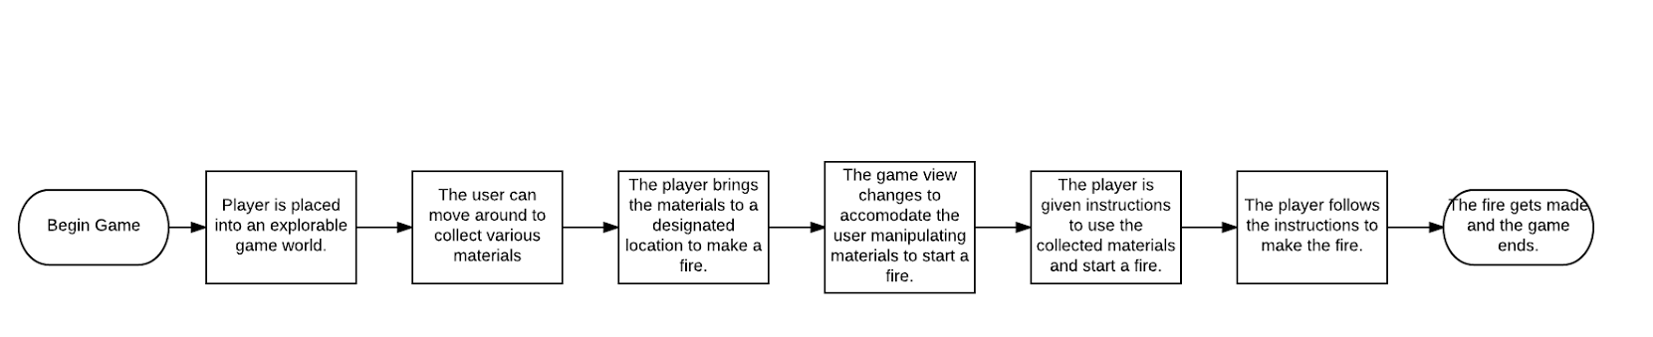
UML Diagram - Flowchart
Notes:
Slade

Slide 8
Any Questions?

